Slide 1
Real-time static gesture detection using Machine Learning
From: Sandipgiri Goswami
Supervisor : Dr.Kalpdurm Passi

Slide 2
Contents
About Languages
Objective
Dataset
Hardware & Software Configurations
Technologies Used
About Image Processing
About Machine Learning

Slide 3
About Language:
The method of human communication, either spoken or written, consisting of use of words in structured and conventional way.
There are roughly 6,500 spoken languages in the world today.
English as a global language.
With more than 350 million people around the world speaking English as a first language and more than 430 million speaking it as a second language.

Slide 4
About Sign Language:
People of group use symbolic language to communicate with other people. This symbolic language is call sign language.
Sign Language is a build for communication used worldwide among hearing, hard of hearing, and deaf peoples.
Sign language is not a unique language signed consistently in different country.
Different counties have their own sign language such as American Sign Language, French Sign Language, Indian Sign Language and Puerto Rican Sign Language to a name few.
Gesture based communication is dependent on region and has significant differences from other languages.

Slide 5
About Sign Language
Sign Language is a language which uses to convey message by hand movements, facial expression and body language to communication.
It is mainly used by deaf and people who can hear but cannot speak.
Sometime family member and relatives must learn sign language to interpreters which enable deaf and wider communities to communicate with each other.
In fact, there are somewhere between 138 and 300 different types of sign language used throughout the world today

Slide 6
Different Sign Language in the Americas
North America | Central America | South America
•American Sign Language •Inuit Sign Language •Quebec Sign Language •Puerto Rican Sign Language | •Costa Rican Sign Language •Guatemalan Sign Language •Honduras Sign Language •Mayan Sign Language •Mexican Sign Language •Nicaraguan Sign Language •Panamanian Sign Language •Salvadorian Sign Language •Tijuana Sign Language | •Argentine Sign Language •Bolivian Sign Language •Brazilian Sign Language •Chilean Sign Language •Colombian Sign Language •Ecaudorian Sign Language •Paraguayan Sign Language •Peruvian Sign Language •Uruaguayan Sign Language •Venezuelan Sign Language

Slide 7
Misunderstandings about Sign Language
Most people who are not disable think that sign language is just simple a manual representation of the spoken language which is not true.
In fact, our language and sign language of the deaf have little in common.
Sign language has the difficulty of the verbal language but it is self-determining from the alphabets
The best example is British Sign Language and American Sign Language which are meaningless although the facts that disable people from United States and Britain perfectly understand each other.
Another common misunderstanding about sign language is that it globally understandable which is of course not true. As explained above, the sign language that is used by the deaf in Unites States and Britain are very not the same

Slide 8
Objective:
My thesis main objective to help deaf community to increases their self-esteem and IQ level and improve their communication skill. Student who are deaf or have a deaf parent or have a close relative with deaf individual will learn by themselves about sign language alphabets and numbers.
Deaf community will learn their first step toward to American sign language. Although correct usage of sign gesture plays very important part in effective communication.
Deaf student also encouraged to establish connection to deaf community and to carry their new knowledge and skill beyond the class room and into the community at large.

Slide 9
About American Sign Language(ASL)
American Sign Language is implemented from French sign language which was introduced by Thomas Hopins Gallaudet in United States.
ASL is similar to French sign language; Individuals who speak American Sign Language are able to effectively communicate in French Sign Language.
A variation of American Sign Language also exits. Similarly, to English which is international language, but it has unique variations between English spoken in England, United States or Australian, there are separate difference that have changed in sign language.

Slide 10
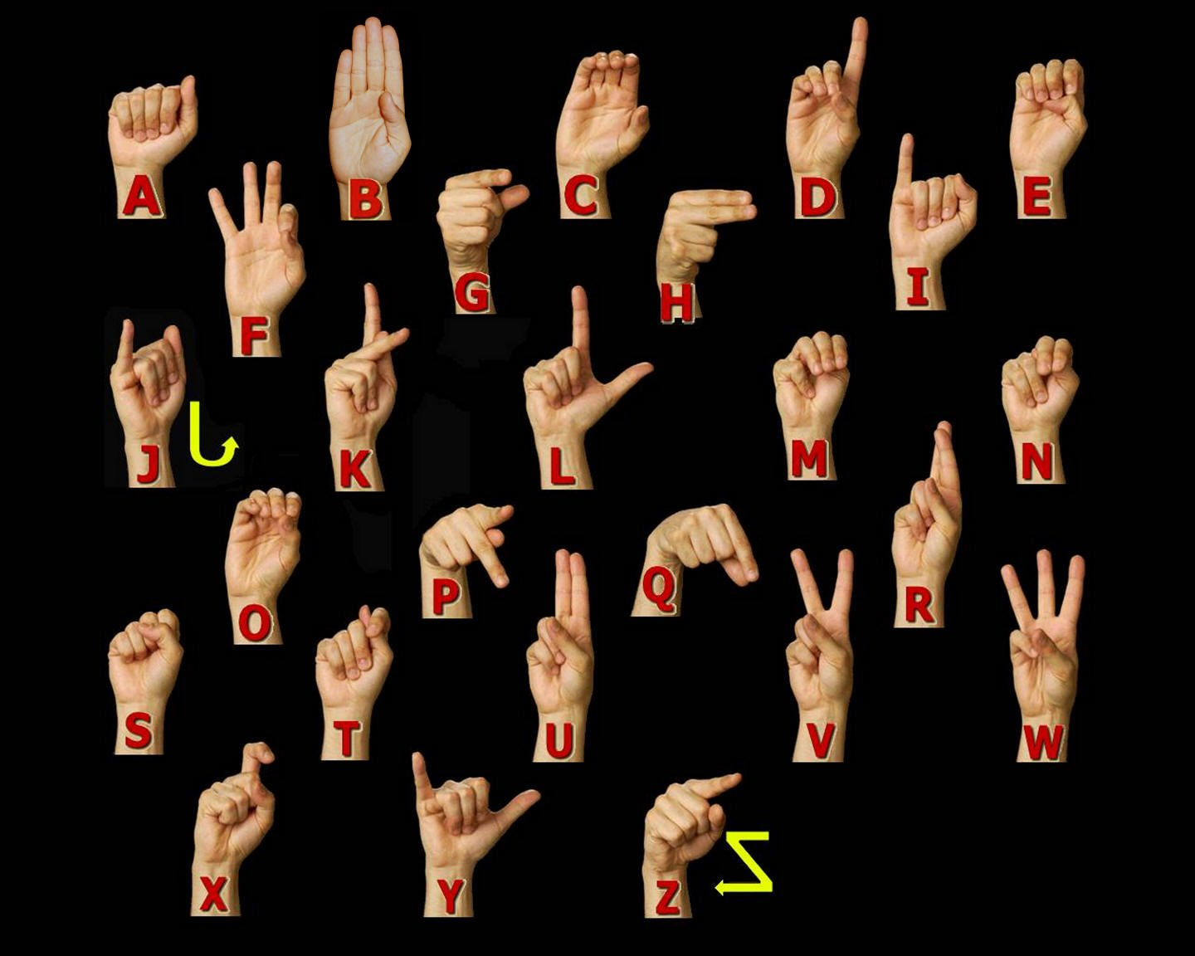
ASL Manual Alphabet

Slide 11
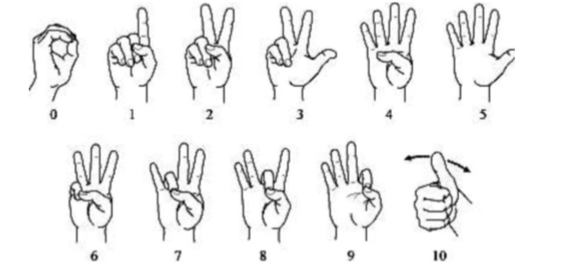
American Sign language numbers

Slide 12
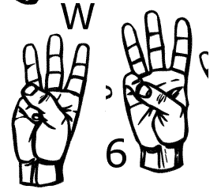
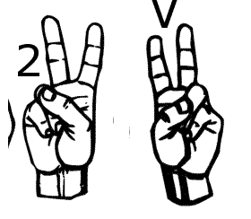
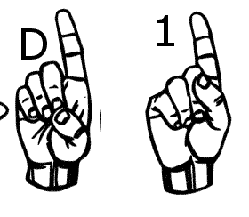
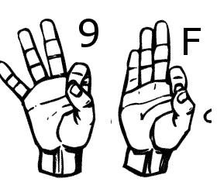
Similar Sign Gesture

Slide 13
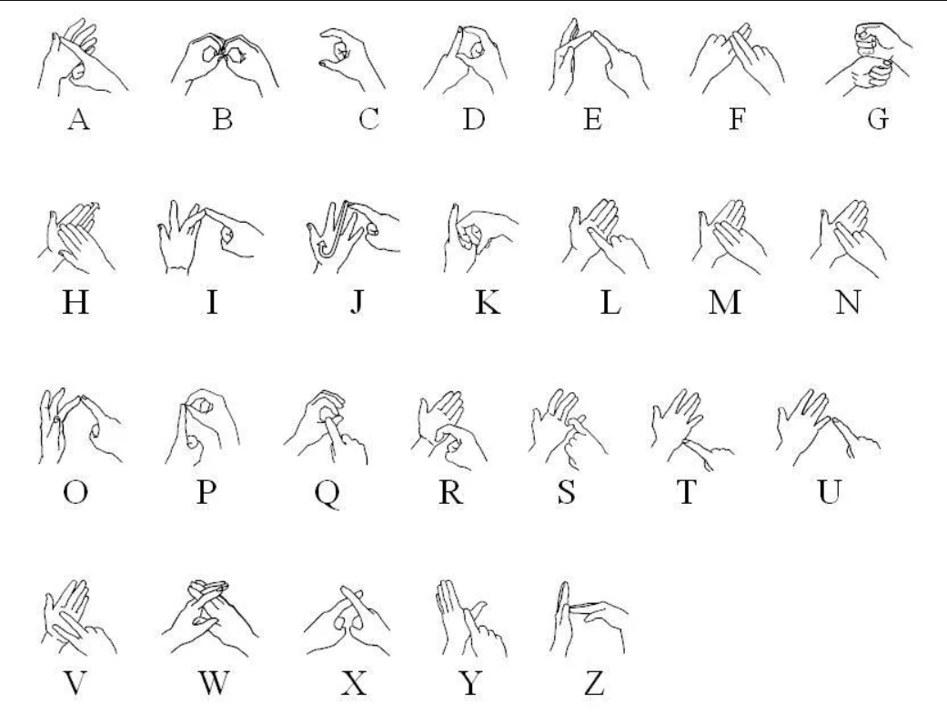
British Sign Language

Slide 14
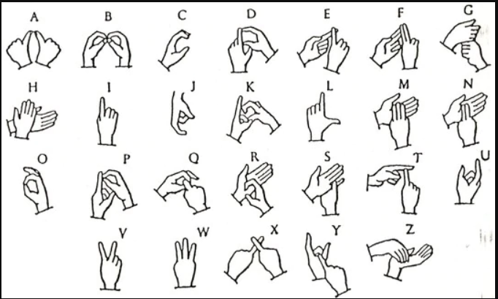
India Sign Language

Slide 15
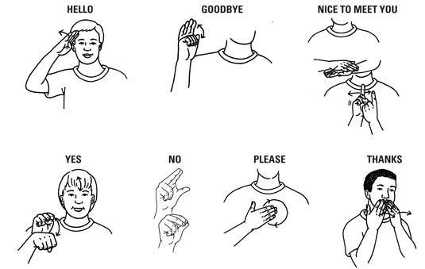
A few words in Sign language

Slide 16
Statistics about sign language use in Canada
American Sign Language | 2,485
Quebec Sign Language | 730
Sign languages, not included elsewhere | 5,780

Slide 17
Statics about Knowledge of Sign Languages
American Sign Language | 11,110
Quebec Sign Language | 730
Sign languages, not included elsewhere | 5,780

Slide 18
Dataset and variables:
I have created my own data set. This dataset was a collection of 36 which contain A to Z alphabet and 0 to 9 numbers digit.
In my dataset consist of A to Z alphabet and 0 to 9 numbers where I have used right hand to capture 1200 images for specific alphabet and numbers.
After that I implement code which convert flip image to right to left hand image.
The height and width ratios vary significantly but average approximately 50X50 pixel.
The dataset contains over 84,600 images in gray scale color. Additionally, People who want to add their images to this dataset than they can add.

Slide 19






Data set Sample
S | A | N | D | I | P

Slide 20
Dataset Description and Image property
Property | Description
Alphabets | A to Z
Numbers | 0 to 9
Color | Gray Scale
Dimensions | 50x50
Height | 50 pixels
Width | 50 pixels

Slide 21
Hardware Configurations
GPU | GeForce GTX 1080 4GB
CPU | Intel(R) Core(TM) i7-8550 CPU @ 2.00GHz
Memory | DIMM 1333MHz 8GB

Slide 22
Software Configurations
Keras | 2.04
Tensorflow | 1.1.0
Python | 3.53
Operating System | Window 10
Open CV | 2.0

Slide 23
Image Processing
A general explanation of computer vision in image processing can be brief in the following steps:
Image capture - Image is captured using a camera or similar device and digitized.
Pre-processing – A captured image is modified to highlight important features such as noise reduction, contrast normalization etc.
Segmentation detection - Selection of region of interest like edges, similar surfaces.
Description – Feature extraction of radiometric, photometric descriptors and so on.
Classification - Some means to categorize the object.

Slide 24
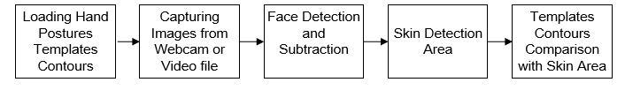
Hand posture detection steps

Slide 25
Machine Learning Approach
There are mainly two different types of machine learning methods:
Unsupervised Learning
Supervised Learning

Slide 26
Unsupervised Learning
In the unsupervised learning method, the model is trained by detecting new data and take out patterns in the date without being instructed on what they are.
The model can learn from data without supervision.
This means that there is no need for input data to be explained.
Required smaller time and resource's to deploy.
The mainstream of unsupervised learning procedures belongs to a group called clustering algorithms.

Slide 27
Unsupervised learning models methods:
K-means -clustering model
Self Organizing Maps (SOMs)
Principal Component Analysis (PCA) - dimensionality reduction

Slide 28
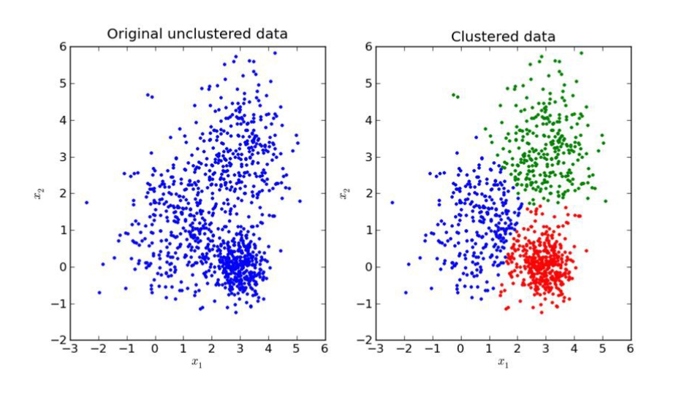
Unsupervised Learning Image

Slide 29
Supervised Learning
The supervised learning method is more commonly used.
This method needs training data with a specific format. Each instance must have assigned label.
Training process of supervised learning as follow
First, the training data are fed into the model to produce estimates of output.
This estimate is compared to the assigned label of the training data in order to evaluate model error.
Based on this error the learning algorithm alters model’s parameters in order to reduce it.

Slide 30
Neural Network Architecture
Single layer feed forward network.
Learning in feed-forward networks use for supervised learning, in which pairs of input and output values are supply into the network for many loop, so that the network trained the interconnection between the input and output.
Multilayer Feed Forward Network
Back propagation is a method used in artificial neural networks to calculate a gradient that is needed in the calculation of the weights to be used in the network
Self Organizing Map(Unsupervised Learning)

Slide 31
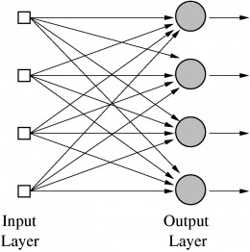
Single Layer feed forward network

Slide 32
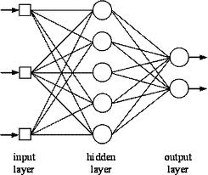
Multilayer feed forward network

Slide 33
Multilayer feed forward network
Input layer-It contains those units (Artificial neurons) which get contribution from the outside world on which system will learn, perceive about or generally process.
Output layer — It contains units that react to the data about how it’s learned any task.
Hidden layer — These layers are in between input and output layers. The main objective of hidden layer is to transfer the input into something that output unit can use and analysing.
Neural networks are fully connected when every node in hidden layer is fully connected to the every node in its previous layer(input) and to the next layer (output) layer.

Slide 34
Thank you

